Slide 1


Name
Alejandro Fernandez
Age: 24
Employment: College Student
Personality keywords:
Fitness
Music
Business
Alejandro or as his friends know him, Alex, is a postgraduate student studying global business student with a passion for music. He loves to find upbeat songs for the gym
Help people in new and innovative ways
Grow a successful business
Make connections with industry leaders
Personal motivations
Cares about growing himself
and his skills
Social motivations: Wants to make a business that
Has positive impacts around the
Globe
Financial motivations:
There is much money to be
Earned as a founder
Story
Goals
Personality:
Outgoing
Analytical
Also be better than yesterday
Not put people down as we grow
- Give up before trying
We must:
We must not:
Phone
Tablet
Laptop
Desktop
Social net

Slide 2

Name
Ashley Stevens
Age: 37
Employment: Event Coordinator
Personality keywords:
Calm
Organized
Ashley has worked at many venues helping to book musicians from all around to preform. She has dealt with big producers and small independent artists and is also on the hunt for the next big artist wherever they are on their jounrey
Bring people happiness through the events she holds
Help musicians grow their career
Learn what it takes to make music of her own
Personal motivations
Wants to learn as much as
Possible
Social motivations: Wants to give people a good
Time through music
Financial motivations:
The bigger show the more she
Makes
Story
Goals
Personality:
Driven
Studious
Workaholic
Build the best vibes we can for the people around us
- Let our ego’s get the best of us
We must:
We must not:
Phone
Tablet
Laptop
Desktop
Social net

Slide 3
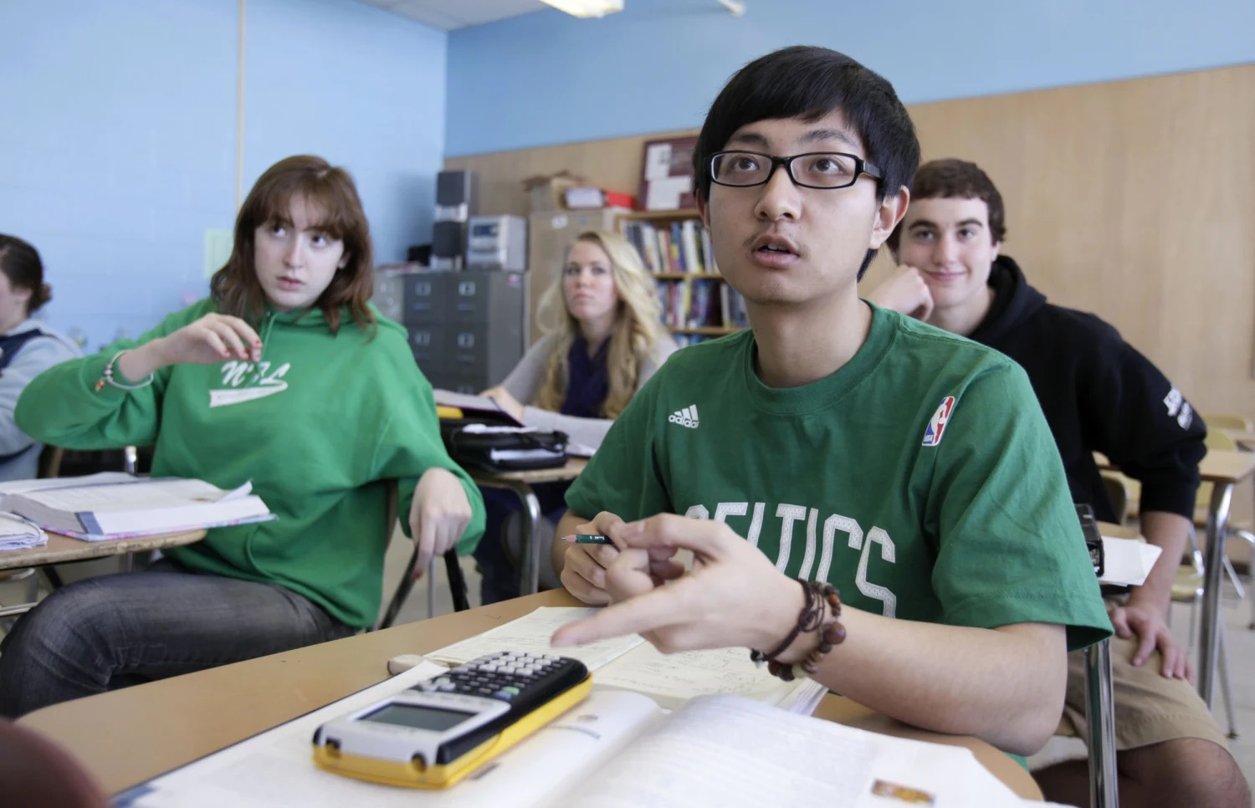
Name
Zheng Liu
Age: 16
Employment: High School Student
Personality keywords:
Friends
Games
Liu loves to hang out with friends any chance he gets. And one the most important things to him is setting the mood with some music. He is always trying to make sure the music fits the setting and loves to get merch from his favorite artists
Meet as many people as he can
Create memories and have music to match them
Personal motivations
Wants to have friends he will
Remember forever
Social motivations: Wants to show others music
That they remember
Financial motivations:
Not a concern to him as long
As he can afford his petrol
Story
Goals
Personality:
Enthusiastic
Helpful
Good Friend
Hear everyones stories
Broaden our horizons
- Give up before trying
We must:
We must not:
Phone
Tablet
Laptop
Desktop
Social net

Slide 4
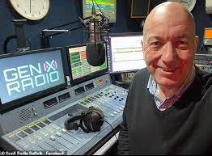
Name
Edward Jones
Age: 66
Employment: Retired Radio Host
Personality keywords:
Talking
Media
Ed worked in the radio business for over 30 years. It was his passion. And he has not been able to let go since he retired. He now has a blog about music new and old alike. He has been trying to expand past his specialty, rock music and has been searching the web for new musicians with interesting stories
Continue his passion on the side
Teach others about the struggles of the music business
Personal motivations
Give other people a passion
For music just as he feels it
Social motivations: Share others stories to more
People
Financial motivations:
Make enough to run his blog
Story
Goals
Personality:
Generous
Funny
Share out passions with the world
- Make assumptions based on our biases
We must:
We must not:
Phone
Tablet
Laptop
Desktop
Social net

